Slide 1

Now That You Are a Data Scientist, What Next?
An Analytical Summary for the job of a Data Scientist by average salary, job title, skills required, and industry/sector .
An Industry report compiled by:
<L><A><J>
(Lien Lai, Abi Akinlotan, Jennifer Carden)

Slide 2
Who is a Data Scientist?
O’Neil, C., and Schutt, R. Doing Data Science
“More generally, a data scientist is someone who knows how to extract meaning from and interpret data, which requires both tools and methods from statistics and machine learning, as well as being human. She spends a lot of time in the process of collecting, cleaning, and munging data, because data is never clean.”
Shashi Upadhyay, CEO of Lattice
“Data Scientists are referred to as ‘UNICORNS’. They are professionals with a diverse skillset that is not commonly found in a single individual”

Slide 3

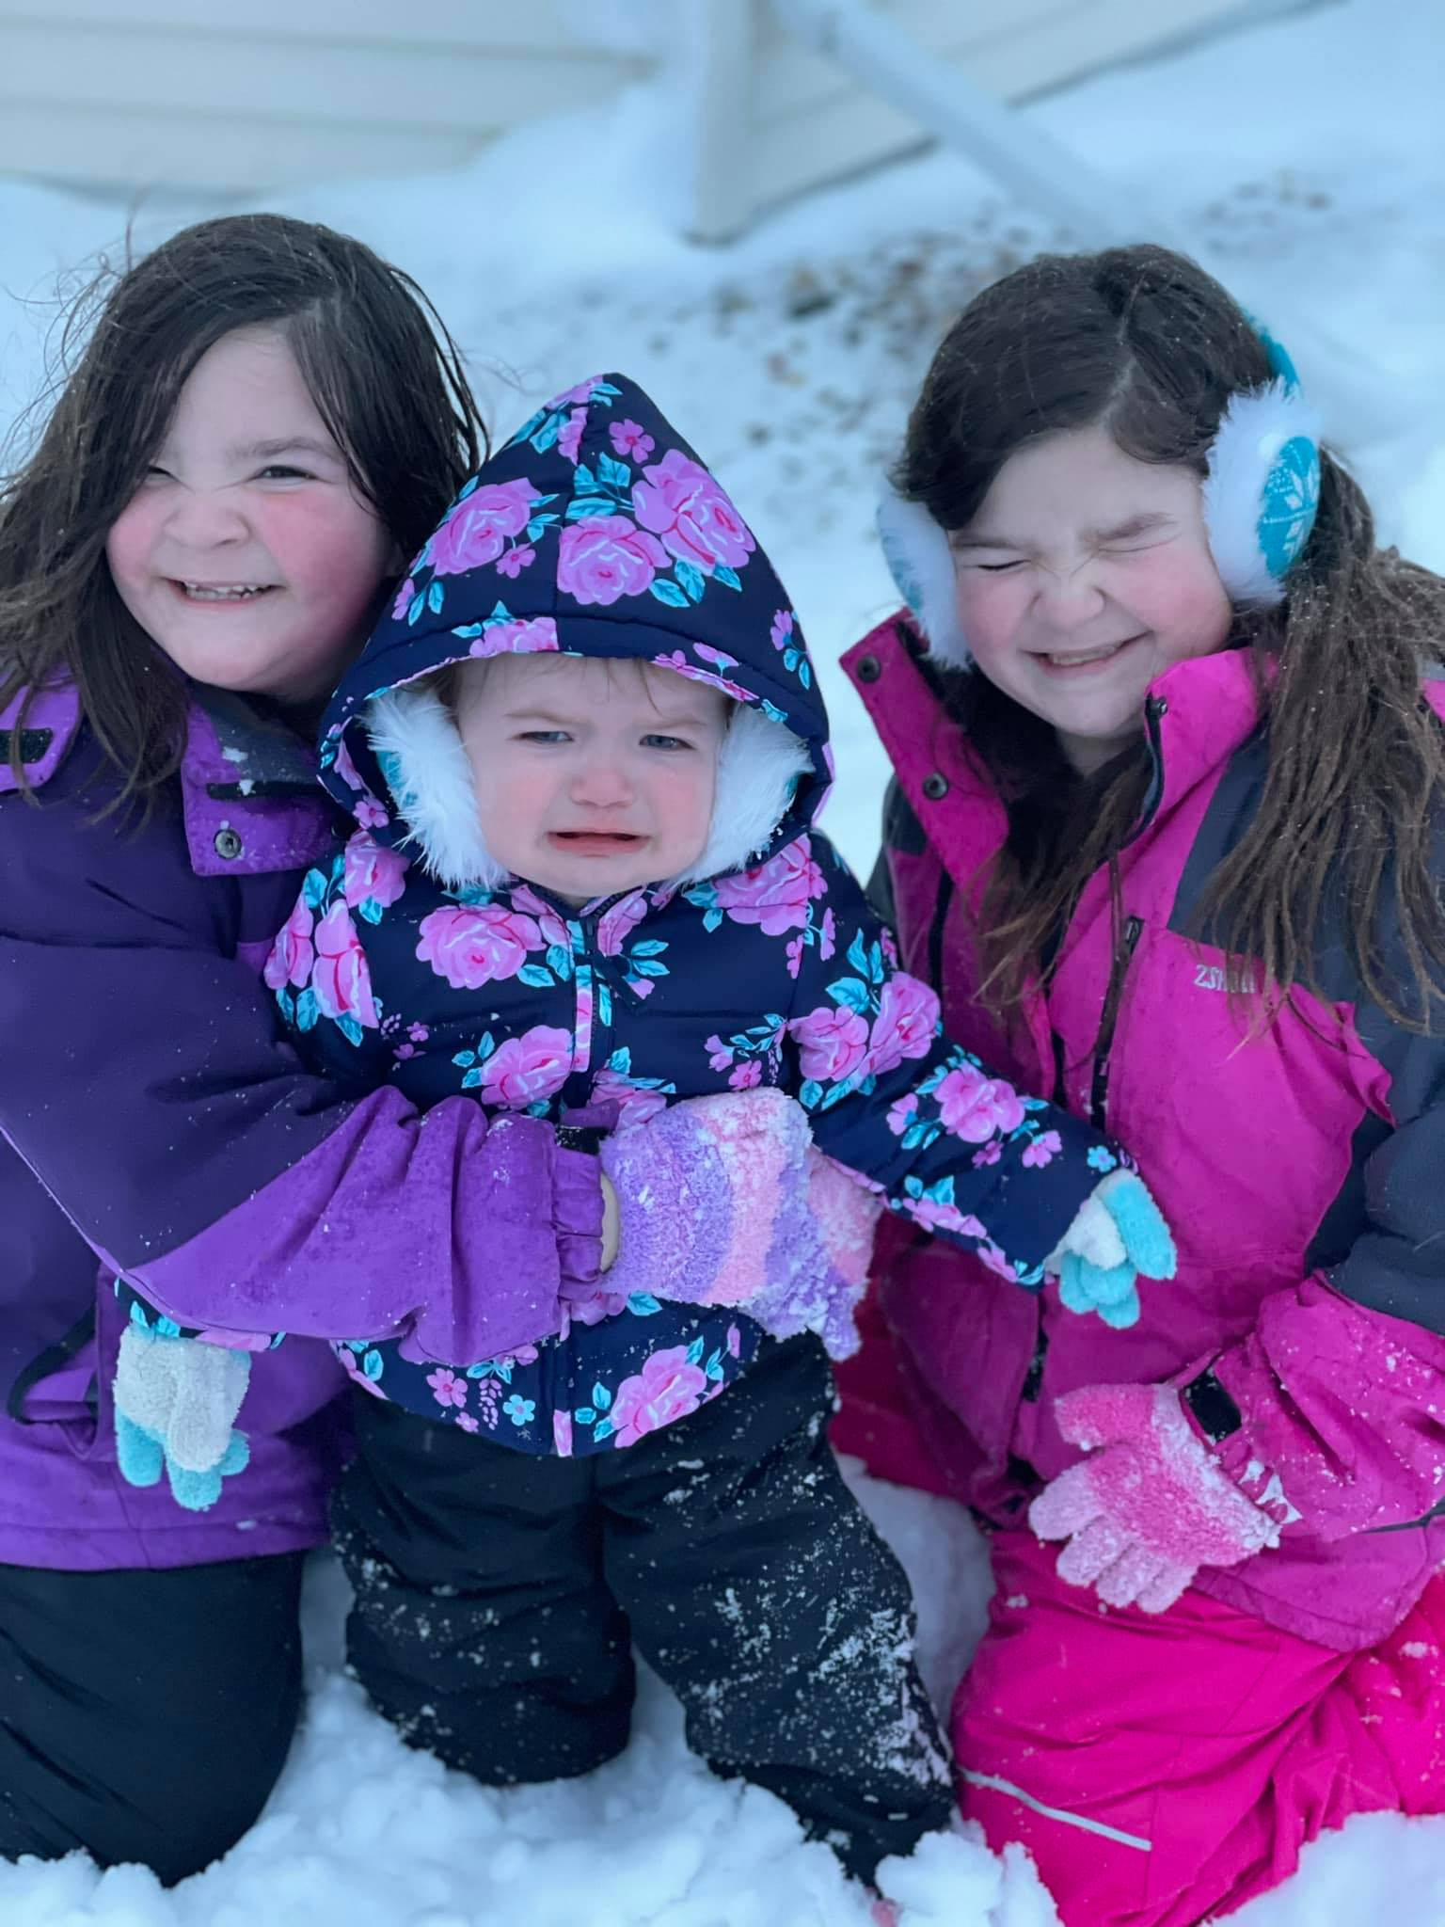
Jennifer Carden
Married with three kids.
All girls! Ages 8 (twins) and 17 months.
From Panama City FL but moved to Fargo ND last year.
I love a challenge and strive to apply 110% in everything I do.

Slide 4


Lien Lai
Married with three kids.
All Girls! Oldest is 18 yr, middle is 16 yr and youngest is 9 yr.
My sister and niece(who is 10 yr.) live with us.
We do everything together.
I have a BA in Arts
I’ve been working with children for the past 18 years.

Slide 5

Abi Akinlotan
First of 3 sisters, we are close-knitted and very protective of each other.
I have a BSc in Microbiology.
Over the years I have deployed data insights to marketing strategies and building business solutions.
I currently work in the Healthcare Sector but secretly wish I was either coding or growing a startup.

Slide 6

DATA SCIENCISTS’ SALARIES (2021)
This Dataset contains information on ratings, average salaries, necessary skills, sector, location and industry requirements for the position of a Data Scientist.
Library: Kaggle
https://www.kaggle.com/nikhilbhathi/data-scientist-salary-us-glassdoor?select=data_cleaned_2021.csv

Slide 7
What Does a Data Scientist/Analyst Do?
> Statistical Analysis and Computing
> Process Large data sets
> Machine Learning
> Deep Learning
> Data Visualization
> Data Wrangling
> Mathematics
> Statistics
> Programming
> Big Data

Slide 8
How Does Data Science Make a Difference in our Lives?

Slide 9
What skills are needed in Data Science?
Technical
Programing
Non-Technical
Strong Business Acumen
Knowledge of SAS and Other Analytical Tools
Adept at Working with Unstructured Data
Good Communication Skills
Great Data Intuition

Slide 10
Results

Slide 11
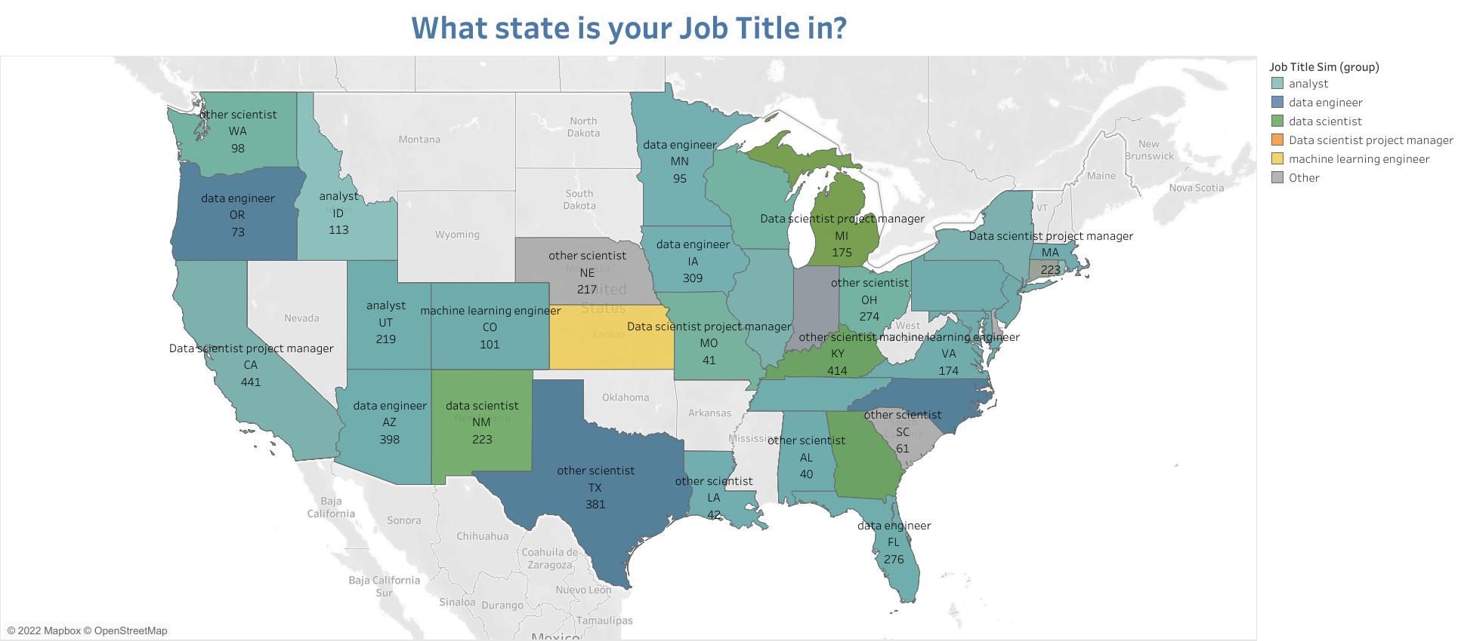
Job title

Slide 12
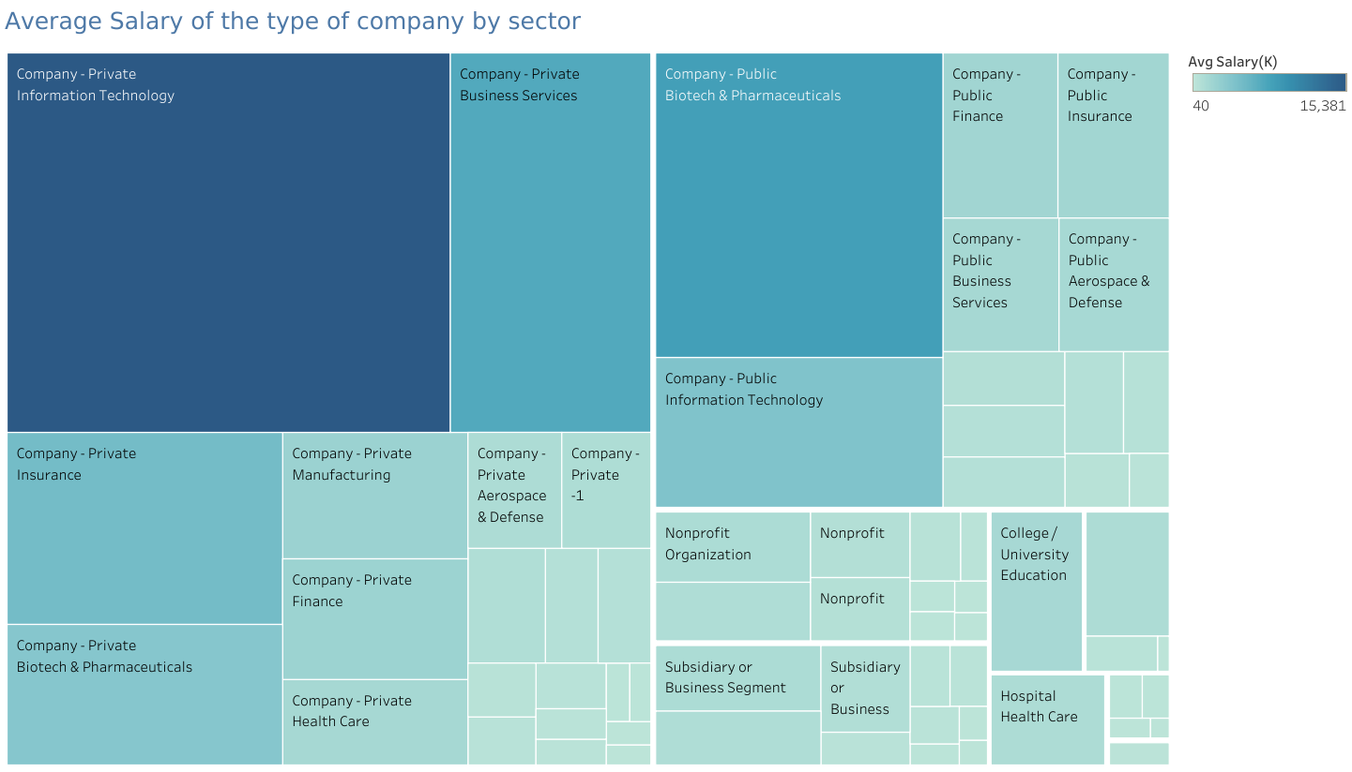
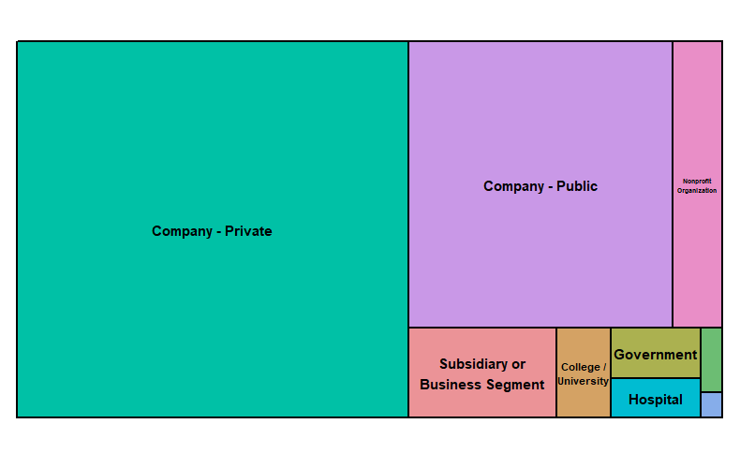
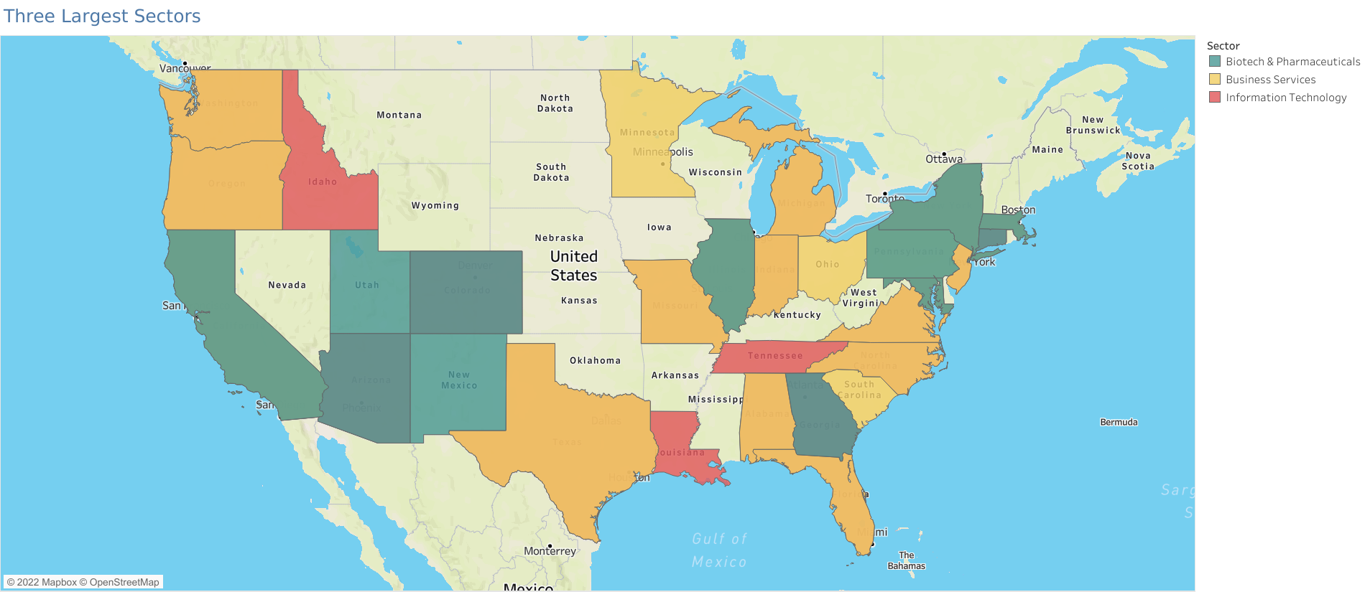
Which type of Company pays the most?
Where are the top three types located?

Slide 13
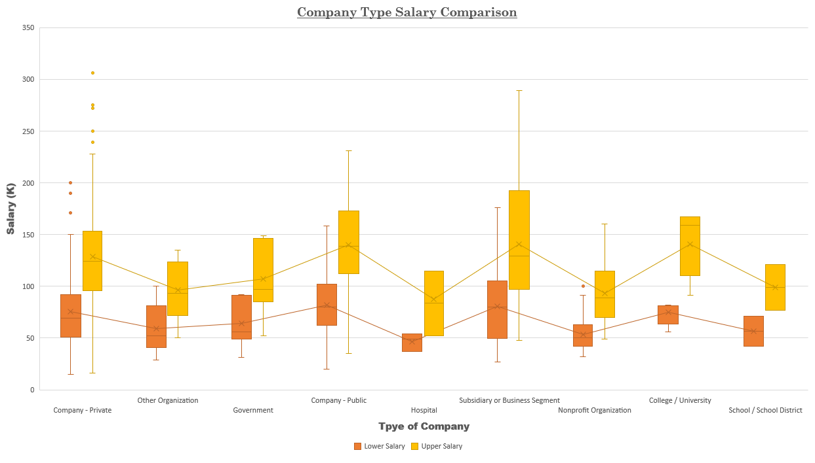

Slide 14
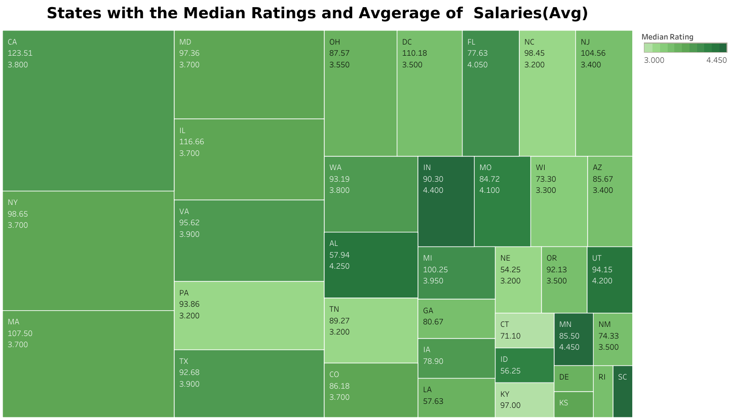
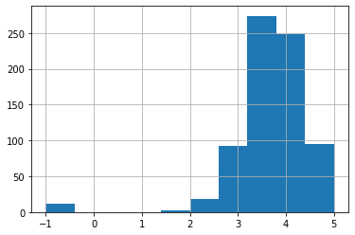
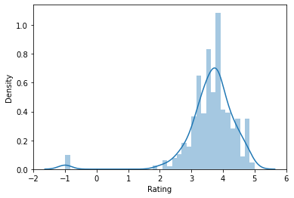
Majority of the companies have a rating between a 3 and 4.

Slide 16

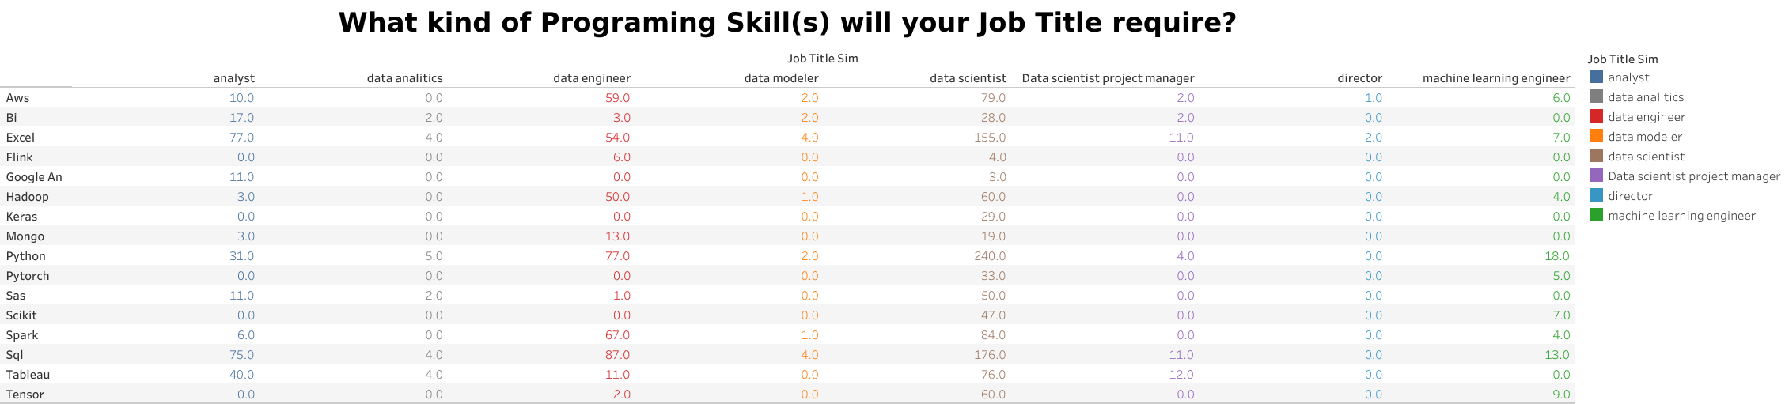
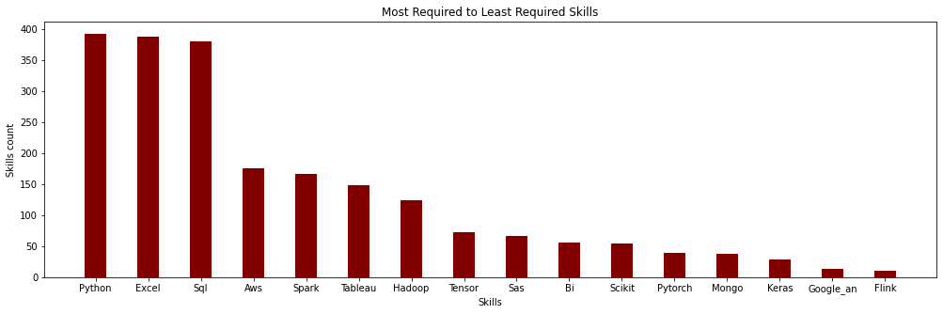

Slide 17
Call:
lm(formula = NewSector ~ spark + aws + tensor + bi + mongo +
google_an, data = bindSalaries)
Coefficients:
(Intercept) spark aws tensor bi mongo google_an
5.049 -1.677 -1.091 1.486 1.201 3.634 7.819
Call:
lm(formula = NewSector ~ spark + aws + tensor + bi + mongo +
google_an, data = bindSalaries)
Residuals:
Min 1Q Median 3Q Max
-9.868 -3.049 -1.049 1.951 21.628
Coefficients:
Estimate Std. Error t value Pr(>|t|)
(Intercept) 5.0488 0.2104 23.994 < 2e-16 ***
spark -1.6768 0.4324 -3.878 0.000115 ***
aws -1.0909 0.4105 -2.658 0.008042 **
tensor 1.4865 0.5765 2.579 0.010114 *
bi 1.2013 0.6263 1.918 0.055489 .
mongo 3.6342 0.7846 4.632 4.29e-06 ***
google_an 7.8193 1.2132 6.445 2.10e-10 ***
---
Signif. codes: 0 ‘***’ 0.001 ‘**’ 0.01 ‘*’ 0.05 ‘.’ 0.1 ‘ ’ 1
Residual standard error: 4.475 on 731 degrees of freedom
(4 observations deleted due to missingness)
Multiple R-squared: 0.1135, Adjusted R-squared: 0.1062
F-statistic: 15.6 on 6 and 731 DF, p-value: < 2.2e-16

Slide 18

Top 5 companies that had the most counts:
Mass Mutual is an insurance company in Spring Field, Massachusetts. They are deal with life insurance, retirement, college and home budgeting plans.
Reynolds American is a Research Tobacco company in Winston-Salem, NC. They are the subsidy company to the British American Tobacco P.L.S and parent to the products of Newport, Camel, Snus and some others.
Takeda Pharmaceuticals is a Japan owned company that has world wide officed in US, Europe, and Canada. The US company is in Lexington, MA. They focus research on oncology, rare diseases, neuroscience, gastroenterology, plasma-derived Therapy, and vaccines.
Software Engineering Institute is a research and development center sponsored by the US Dept. of Defense in Pittsburg, PA. SEI has delivered innovative methods, tools, algorithms, and frameworks to meet current software and cybersecurity needs and provide a foundation for combating future ones.
PNNL is a research facility in Washington State. PNNL’s core capabilities are organized into five areas:
> 1. Chemical and Materials Sciences,
> 2. Computational and Mathematical Sciences,
> 3. Earth and Biological Sciences,
> 4. Engineering, and
> 5. User Facilities and Advanced Instrumentation.

Slide 19
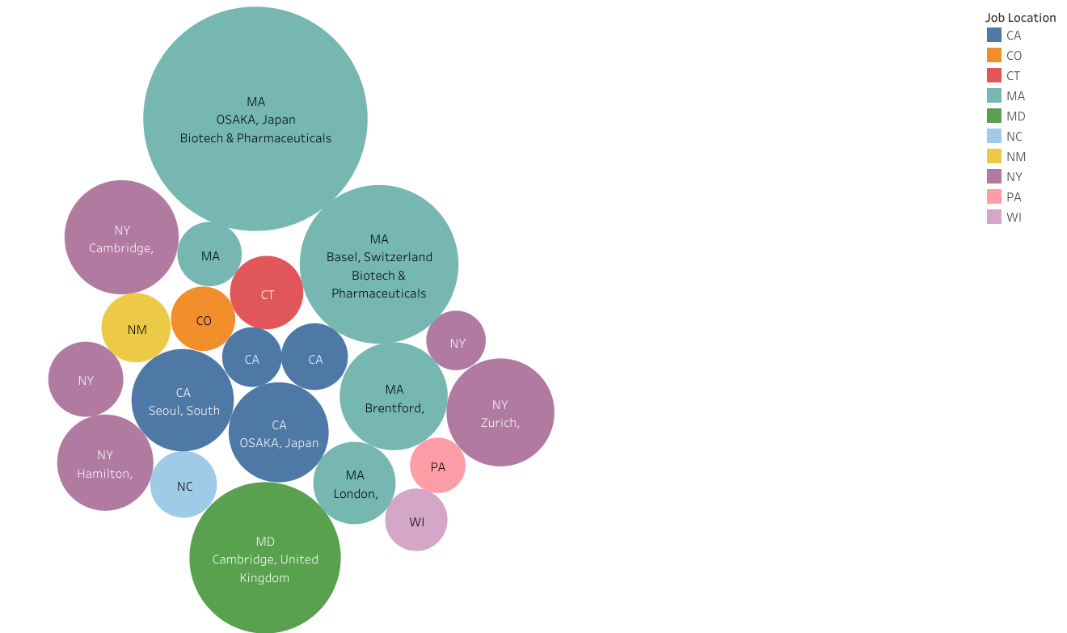
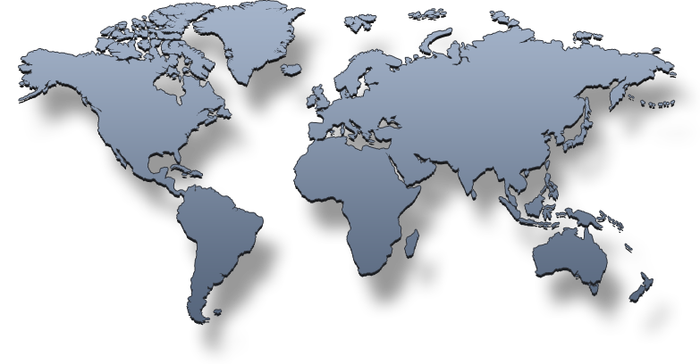
Bubble graph
Not All Companies are in the US

Slide 20
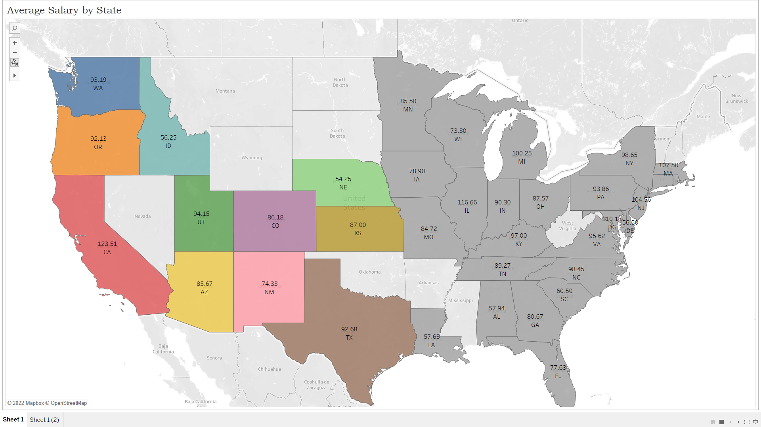
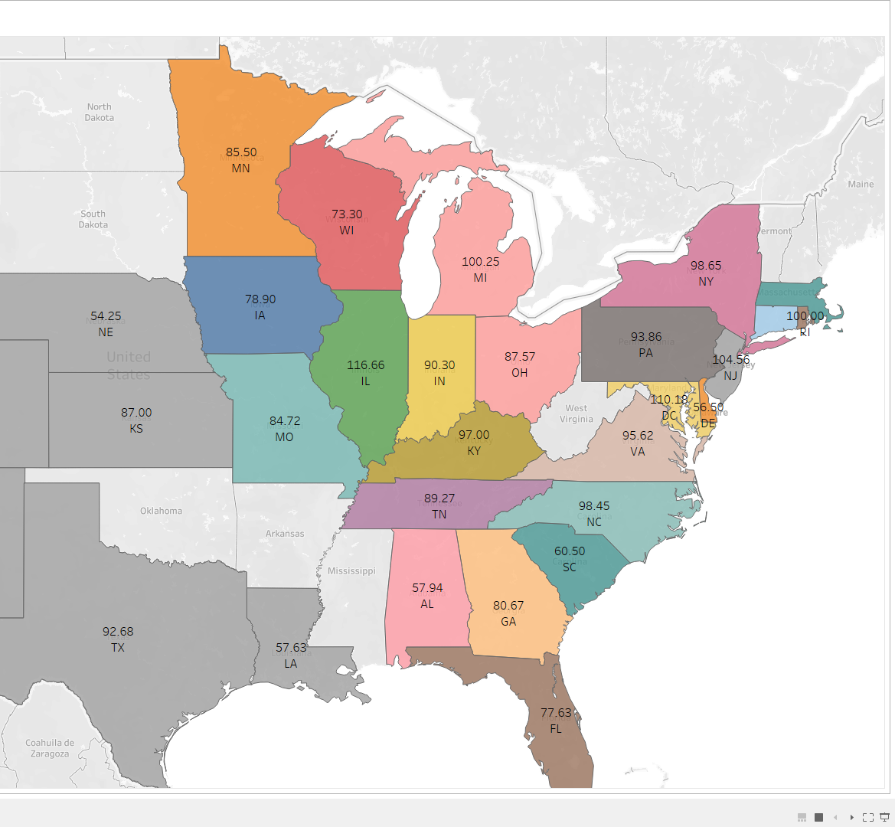
Working on the West Coast Vs. East Coast
West Coast Salaries
East Coast Salaries

Slide 21
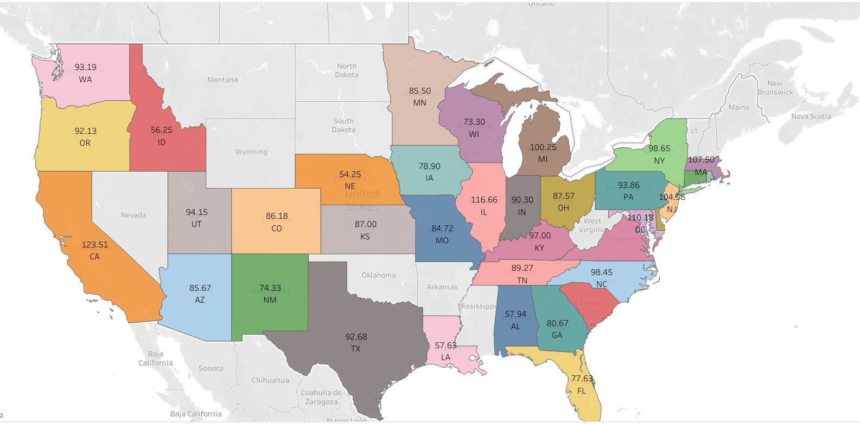
How much could a Data Analyst
make?

